Slide 1
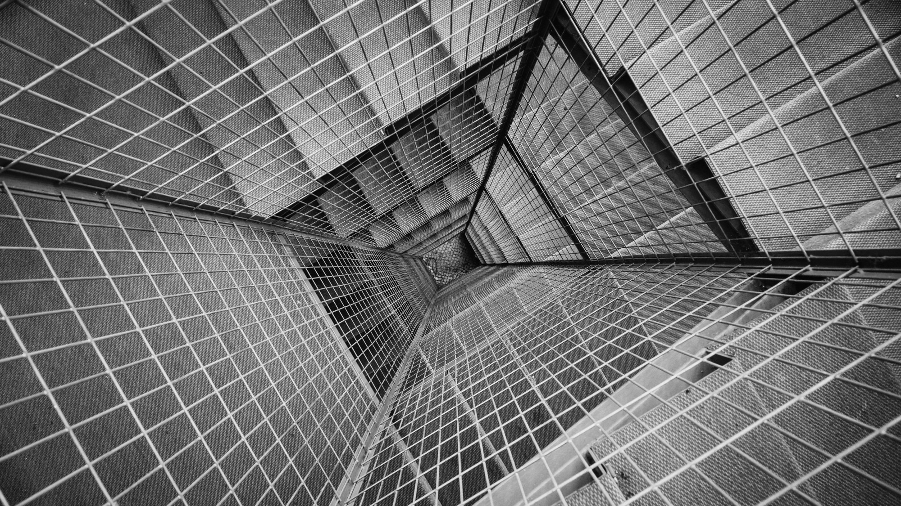
TOTAL TECHNOLOGY
REPORTLAB COMPLETE TUTORIAL
Table in Reportlab
Tutorial 26

Slide 2
How to create table in reportlab
Using table class from platypus module
TOTAL TECHNOLOGY

Slide 3
How to create table
using table class example code
from reportlab.platypus import SimpleDocTemplate,Paragraph,Table
from reportlab.lib.styles import getSampleStyleSheet
pdf=SimpleDocTemplate("tutorial26.pdf")
flow_obj=[]
styles=getSampleStyleSheet()
data=[[str(x) for x in range (1,7)],[str(x) for x in range (1,7)],[str(x) for x in range (1,7)]]
t=Table(data)
flow_obj.append(t)
pdf.build(flow_obj)
TOTAL TECHNOLOGY

Slide 4
How to create table with gridline using tablestyle class
example code
from reportlab.platypus import SimpleDocTemplate,Paragraph,Table,TableStyle
from reportlab.lib.styles import getSampleStyleSheet
from reportlab.lib import colors
pdf=SimpleDocTemplate("tutorial26.pdf")
flow_obj=[]
styles=getSampleStyleSheet()
data=[[str(x) for x in range (1,7)],[str(x) for x in range (1,7)],[str(x) for x in range (1,7)]]
#print(help(Table))
tstyle=TableStyle([("GRID",(0,0),(-5,-2),.1,colors.red),
("GRID",(4,1),(-1,-1),.1,colors.green)])
t=Table(data)
t.setStyle(tstyle)
flow_obj.append(t)
pdf.build(flow_obj)
TOTAL TECHNOLOGY

Slide 5
How to create table custom font and color
example code with font & textcolor
from reportlab.platypus import SimpleDocTemplate,Paragraph,Table,TableStyle
from reportlab.lib.styles import getSampleStyleSheet
from reportlab.lib import colors
pdf=SimpleDocTemplate("tutorial26.pdf")
flow_obj=[]
styles=getSampleStyleSheet()
data=[[str(x) for x in range (1,7)],[str(x) for x in range (1,7)],[str(x) for x in range (1,7)]]
#print(help(Table))
#tstyle=TableStyle([("GRID",(0,0),(-5,-2),.1,colors.red),
#("GRID",(4,1),(-1,-1),.1,colors.green)])
tstyle=TableStyle([("BOX",(0,0),(-1,-1),2,colors.red),
("FONT",(0,0),(-1,-1),"Times-Italic",50),
("TEXTCOLOR",(0,0),(-1,-1),colors.red),
("BACKGROUND",(0,0),(-1,-1),colors.blue),
("BACKGROUND",(4,1),(-1,-1),colors.green)])
t=Table(data)
t.setStyle(tstyle)
flow_obj.append(t)
pdf.build(flow_obj)
TOTAL TECHNOLOGY

